Slide 1
What and for who?
For full-time English medium studies (engineer degree) 2 ECTS
  2nd semester Architecture and 2nd sem. MEiL (Power) - there are groups for 30/60 hours per semester, we will register you.
  Other faculties – only after passing C1 Academic English exam.
For full-time English master studies
  get the permission for the Polish language for 30/60

Slide 2
What and for who?
PhD students – you can apply for 30 hours per semester.
  Erasmus +, exchange students – 2/4 ECTS, 30/60 hours for one semester only if you have declared Polish/local language at your Learning Agreement [excluding MEiL faculty].
  ask your Erasmus coordinator if he/she had send list of Erasmus students to the language school, so you are entitled to register ☺

Slide 3
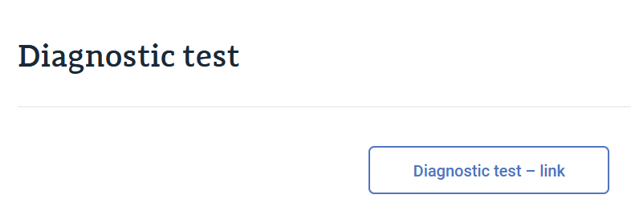
What is my level?
https://www.sjo.pw.edu.pl/studies-in-english/information-for-students/classes-of-polish/

Slide 4
When courses start?
Courses start on 2nd of March,
2026 (Monday) according to the final timetable (classrooms) given at the USOS system and at
www.sjo.pw.edu.pl
You can get 2/4 ECTS!

