Slide 1
Polish language courses
coordinator
mgr Marta Szpak SJO PW
marta.szpak@pw.edu.pl

Slide 2
What and for who?
For full-time English medium studies (engineer degree) 2 ECTS
2nd semester Architecture and 2nd sem. MEiL E3 group - there are groups for 30 hours per semester, we will register you.
Other faculties – only after passing C1 Academic English exam.
For full-time English master studies
get the permission for the Polish language for 30/60

Slide 3
What and for who?
PhD students – you can apply for 30/60 hours.
Erasmus +, exchange students – 2/4 ECTS, 30/60 hours for one semester only if you have declared Polish/local language at your Learning Agreement [excluding MEiL faculty].
ask your Erasmus coordinator if he/she had send list of Erasmus students to the language school, so you are entitled to register ☺

Slide 4
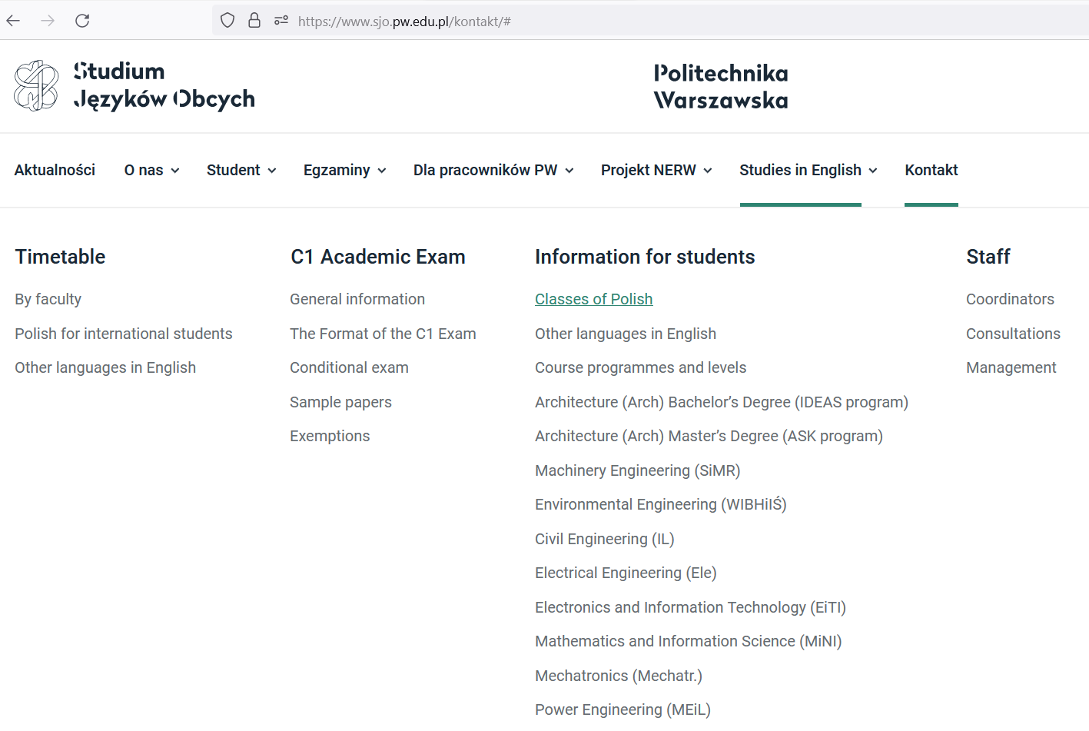
How to register?
see the timetable at www.sjo.pw.edu.pl or at the USOS system

Slide 5
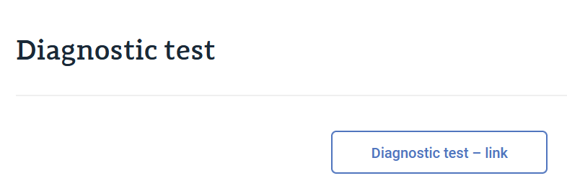
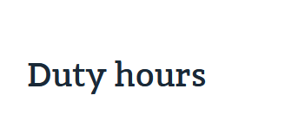
What is my level?
https://www.sjo.pw.edu.pl/studies-in-english/information-for-students/classes-of-polish/

Slide 6
How to register?
Login to USOS system and choose the group and the level
note: USOS codes are not really legible:
So get into the course, go down and see the description of the course:

Slide 7
When courses start?
Courses start on 26th of February,
2024 (Monday) according to the final timetable (classrooms) given at the USOS system and at
www.sjo.pw.edu.pl
You can get 2/4 ECTS!

